Slide 1
General Chemistry
English Experiments
普通化学英语实验
Wan li
Jeremy Dai, Amir
2020-11-13

Slide 2
01
Introduction to the Course ——wan li
02
Safety in Chemistry Lab
——Amir
03
Basic Lab Techniques
——Jereymy,wan li

Slide 3
Basic Information
学生 | 15
班级QQ群
课程时间 | Friday, 2:15 pm
教师 | 李婉 | 63601593 13505516877 | liwan@ustc.edu.cn
助教 | 戴敬诚
 | Amir

Slide 4
2020 Fall Experiment Arrangement
 | 时间 | 项目名称 | 涉及学科
1 | 11月13日 | 实验绪论及化学安全常识 Introduction and Laboratory Safety
2 | 11月20日 | 定量操作练习及糖水溶液中糖分含量测定 The Determination of Sucrose Content by Solution Density | 无机化学实验 分析化学实验
3 | 11月27日 | 无机化合物的性质与鉴定虚拟实验 Properties and Identification of Inorganic Compounds | 无机化学实验
4 | 12月4日 | 碘化锌的制备与电解 Reaction of Zinc and Iodine | 无机化学实验
5 | 12月11日 | 硫酸亚铁铵晶体制备 Synthesis of Ferrous Ammonium Sulfate | 无机化学实验
6 | 12月18日 | 氧化还原反应滴定法测定莫尔盐中Fe²⁺含量 Redox Titration | 分析化学实验
7 | 12月25日 | 配体取代反应的化学热力学研究 Chemical Equilibrium and Thermodynamics of a Ligand Substitution Reaction | 物理化学实验仪器分析实验
8 | 1月8日 | 阿司匹林的制备 Preparation of Aspirin | 有机化学实验

Slide 5
Laboratory Rules
The class begins at 2:15 pm. Coming late will affect your grades.
Missing the class is not allowed. For special circumstance, you must present a note for absence with your head teacher’s signature.
After entering the lab, pick up the key, prepare the experiment according to your Pre-lab work.
After finishing the experiment, get your notebook checked and signed by TA, then clean glassware, lock the drawer, and return the key.
Notes:
5

Slide 6
Learning Method
Step 1
Before class: Pre-Lab Preparation
Step 2
In class: Conducting Experiment
Step 3
After class: Completing Lab report

Slide 7
Lab Report
Step1. Pre-lab Report
1. Purpose
2. Experimental Principle (Chemical equation + short description )
3. Experimental Procedure
4. “preparing for the Experiment” in the manual
Step2. Conducting Experiment
5. Experimental Record
(two columns: left- Procedure, right-Observation or Data)
6. Results (Product appearance, Data collection)
Step3. Lab Report
7. Data Analysis & Summary ( error analysis, Advice)
8. Lab Report Template

Slide 8
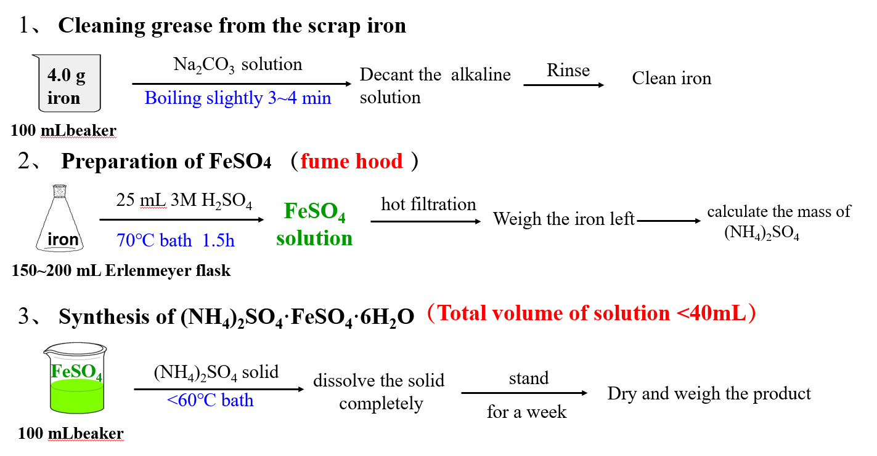
Procedure outline Example

Slide 9
Formal Lab Report
Experiment title Date
1. Purpose
2. Principle
3. Experimental Procedure (outline)
4. Record
5.Data Analysis and experimental results
6. Summary & Advice
Time | Procedure | Observations and Data
Notes:
通常情况下的实验报告，前三项是课前完成，实验后完成五、六。

Slide 10
Rules for Recording Data
All data should be recorded in notebook , not on your hand or filer paper.
Record all data with pen, not pencil or red pen;
The original data cannot be altered casually. If you need alter, you must ask the teacher’s permission.
No pages may be removed from the lab notebook.

Slide 11
Grading Rubric
The final grade -- average of seven experiments
Examination content | grade | notes
Attendance |  | two times late, total score ≤ B+; miss two experiments cannot obtain the credit;
Pre-lab report | 10
Discussion | 5 | Active,
Performance | 30
Experiment Results | 30 | Product: color, yield etc.; Data: accuracy, logical
Lab report | 25 | complete, detailed, legible
Notes:
health

Slide 12
Glassware Items
名 称 |  | 规 格 | 数 量 | 价位 （半价）元
试 管 | Test tube |  | 4 | 1
长颈漏斗 | Funnel |  | 1
洗瓶 | Wash bottle |  | 1 | 5
表面皿 | Watch glass |  | 1(大) 1(小) | 2
玻 棒 | Glass rod |  | 1 | 0.5
滴 管 | Dropper |  | 2 | 0.5
锥形瓶 | Erlenmeyer flask | 50 mL | 1 | 3
 |  | 250 mL | 3 | 3
量 筒 | Graduated Cylinder | 10 mL | 1 | 2
 |  | 25~50 mL | 1 | 2
容量瓶 | Volumetric flask | 250 mL | 1 | 5
移液管 | Volumetric pipet | 20 mL | 1 | 5
吸耳球 | Pipet bulb |  | 1 | 2
磁子 | Stir bar |  | 1 | 5
温度计 | Thermometer |  | 1 | 3

Slide 13
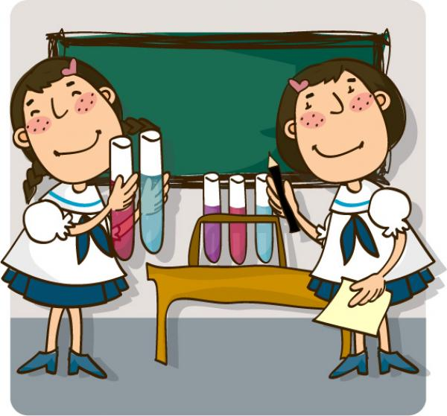
实 验 顺 利
瓶
瓶
罐
罐
看
我
七
十
二
变
酸
酸
碱
碱
中
和
美
好
人
生

