Slide 1
Review
Introduction
Basic Equations
Properties and Theorems
Magnetohydrostatics
Incompressible Steady Flow
Waves
Shocks
Instabilities

Slide 2
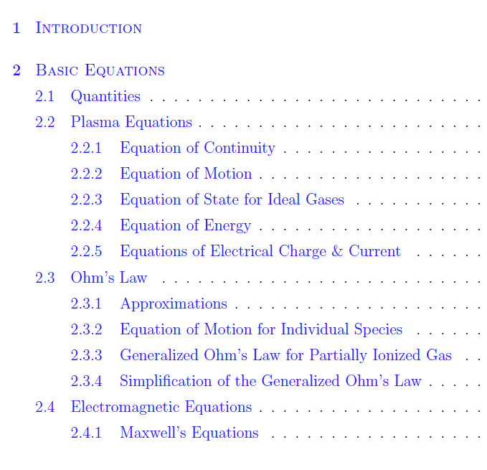

Slide 3
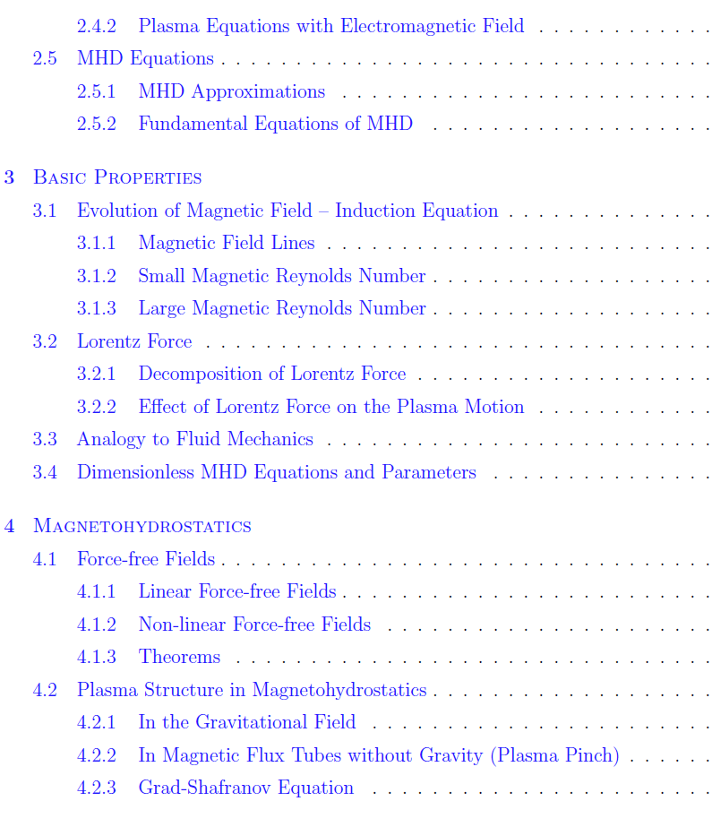
Scale
Frozen-in
Pressure force vs. tension force
Crossing field motion
Flux rope
Shear, Twist
Magnetic energy
Magnetic helicity
Pure vertical/horizontal field

Slide 4
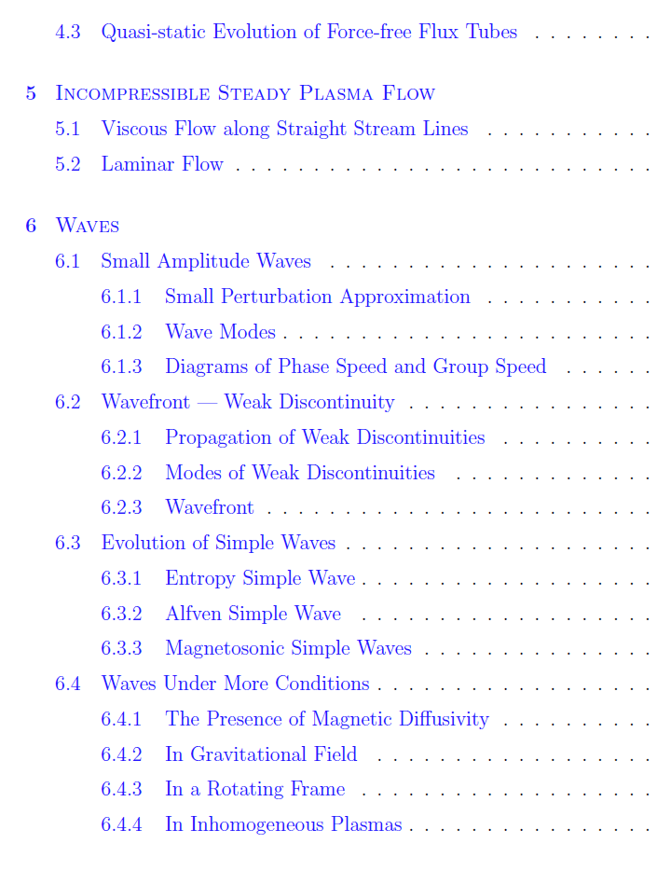
Linearization
Normal mode solution (plane wave solution)

Slide 5
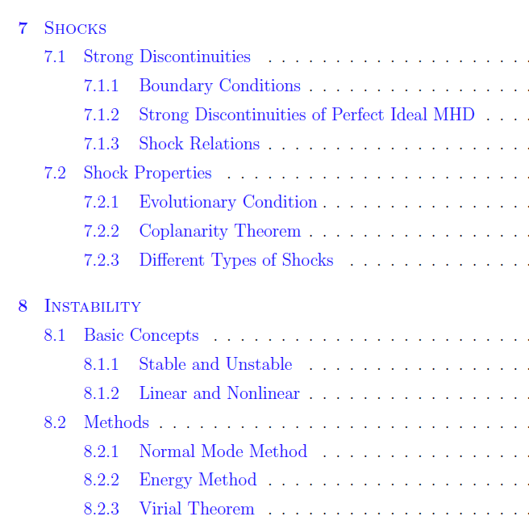
Coordinates, up and down streams
Compression ratio
Summary table
Dispersion relation

